Slide 1
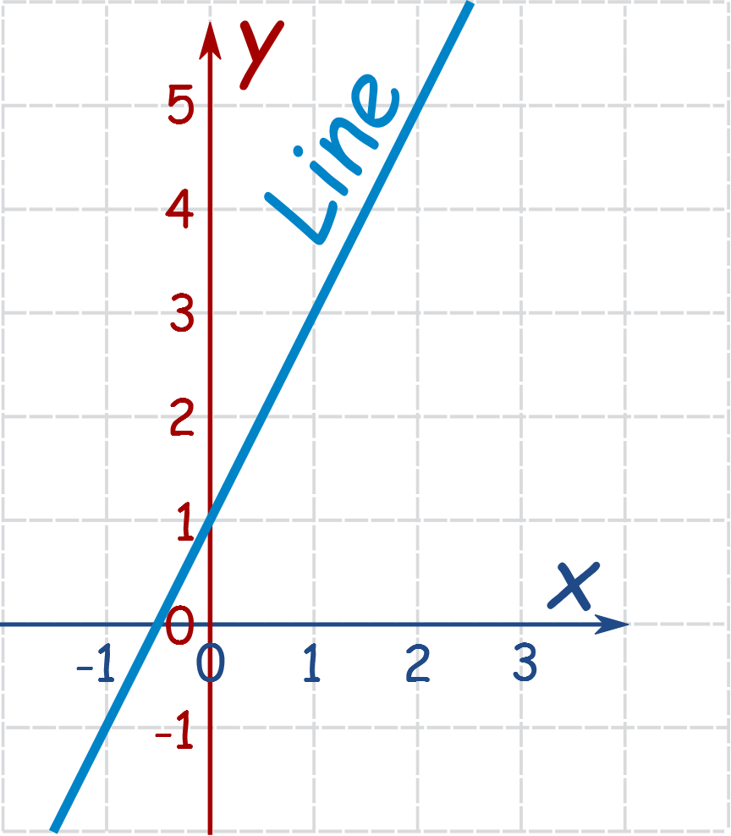
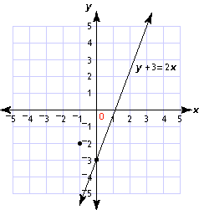
Linear Equations Interactive notebook
Name
Class
Teacher
Term 3 Semester 2

Slide 2
Word equations
Miss L
Year 7

Slide 3
Learning Intentions
Students will be able to
Write mathematical equations
Introduction to Agebra

Slide 4
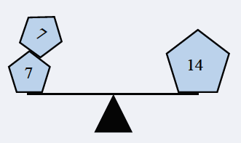
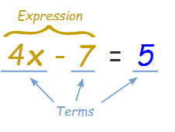
24
7
30
Word Equations
Date:
EQ – How do we correctly write mathematical equations?
An equation is a mathematical sentence in which two expressions are equal
What is an equation?
Numbers, symbols and operators (such as + and ×) grouped together that show the value of something.
What is an expression?

Slide 5


Slide 6
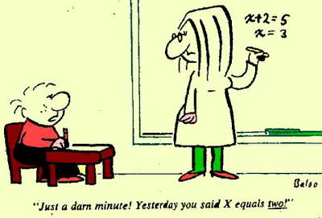
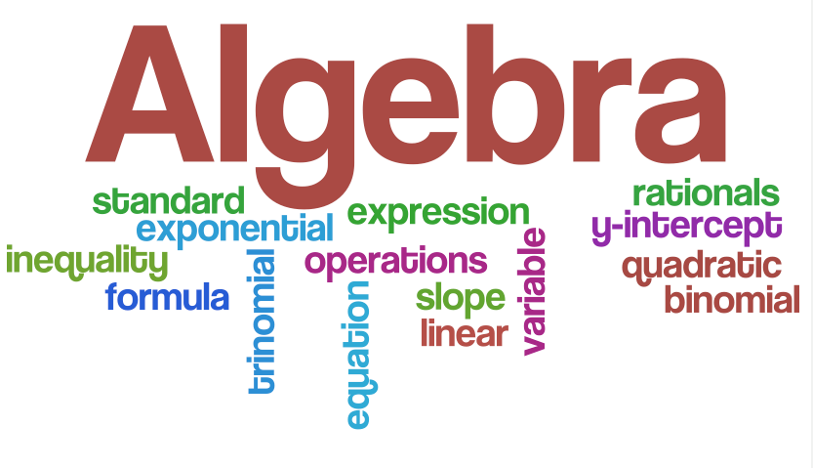
Power-Write
What do you think Algebra means?
How do Mathematicians use Algebra?
Can we use Algebra in everyday life?
Notes:
Guide students through the question.
Option 2: Dot plots handout (Scaffolded for kids who may need extra help)

Slide 7


Box demonstration
How many blocks are there in the box?
    We don’t know……..
Lets label the box with a variable to tell us how many blocks are in the box…… m
    m = number of blocks in the box
m
Notes:
Guide students through the question.
Option 2: Dot plots handout (Scaffolded for kids who may need extra help)

Slide 9
Box demonstration
Lets say we add 2 more blocks into the box
How would a mathematician write that down?
    m + 2 = number of blocks in the box
m + 2 is the expression
m
Notes:
Guide students through the question.
Option 2: Dot plots handout (Scaffolded for kids who may need extra help)

Slide 11
Box demonstration
Lets go back to just m number of blocks
What happens if I take 6 blocks out of the box?
How would a mathematician write that down?
    m – 6 = number of blocks in the box
m – 6 is the expression
m
Notes:
Guide students through the question.
Option 2: Dot plots handout (Scaffolded for kids who may need extra help)

Slide 13
Box demonstration
What happens if I get another box…..
How many boxes do I have then?
How would a mathematician write that down?
    m + m = number of blocks in the boxes
How else can a mathematician write it down?
    2 x m = number of blocks in the boxes
    Or
    2m = number of blocks in the boxes
m
m
Notes:
Guide students through the question.
Option 2: Dot plots handout (Scaffolded for kids who may need extra help)

Slide 14
Box demonstration
Lets go back to just m number of blocks
I add 3 blocks to the box.
How would a mathematician write that down?
    m + 3
What if I told you there is a total of 10 blocks in the box.
How would a mathematician write that down?
    m + 3 = 10
m
Notes:
Guide students through the question.
Option 2: Dot plots handout (Scaffolded for kids who may need extra help)

Slide 16
Box demonstration
    m + 3 = 10
m + 3 and 10 are the expressions
m + 3 = 10 is the equation
How would we work out what m is?
m
Notes:
Guide students through the question.
Option 2: Dot plots handout (Scaffolded for kids who may need extra help)

Slide 17

Your equation has to be balanced on each side
So m is = 7
m + 3
7 + 3
10

Slide 18
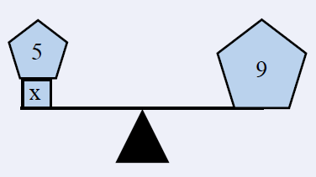
24
7
30
Word Equations
Date:
EQ – How do we correctly write mathematical equations?
How to write an equation?
1 . What is the worded equation?
When a number is added to five the answer is 9
2. How would a mathematician write that down?
number = x x + 5 = 9
3. The two expressions has to be
balanced so what does x equal?
x = 4
4 + 5 = 9

Slide 20
Practice
Notes:
do with the students

Slide 21
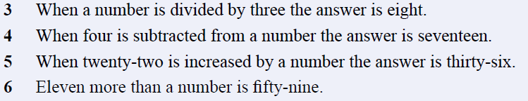

Complete the following:
Don’t forget your summery!!
Task

